Slide 1

...visualizing classifier performance
Tobias Sing
Dept. of Modeling & Simulation
Novartis Pharma AG
Joint work with Oliver Sander (MPI for Informatics, Saarbrücken)

Slide 2
Classification
Binary classification
  (Instances, Class labels): (x₁, y₁), (x₂, y₂), ..., (x_{n}, y_{n})
  y_{i} {1,-1} - valued
  Classifier: provides class prediction Ŷ for an instance
Outcomes for a prediction:
True class
 | 1 | -1
1 | True positive (TP) | False positive (FP)
-1 | False negative (FP) | True negative (TN)
Predicted
class

Slide 3
Some basic performance measures
P(Ŷ = Y): accuracy
P(Ŷ = 1 | Y = 1): true positive rate
P(Ŷ = 1 | Y = -1): false positive rate
P(Y = 1 | Ŷ = 1): precision
True class
 | 1 | -1
1 | True positive (TP) | False positive (FP)
-1 | False negative (FP) | True negative (TN)
Predicted
class

Slide 4
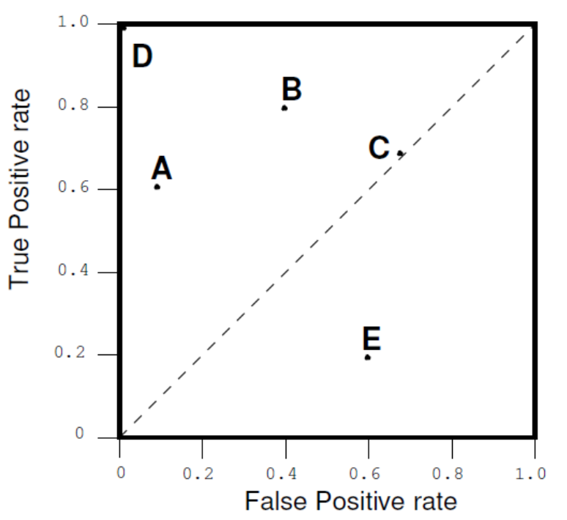
Performance trade-offs
Often: Improvement in measure X →
measure Y becomes worse
Idea: Visualize trade-off in a two-dimensional plot
Examples:
  True pos. rate vs.
  false pos. rate
  Precision vs. recall
  Lift charts
  …

Slide 5
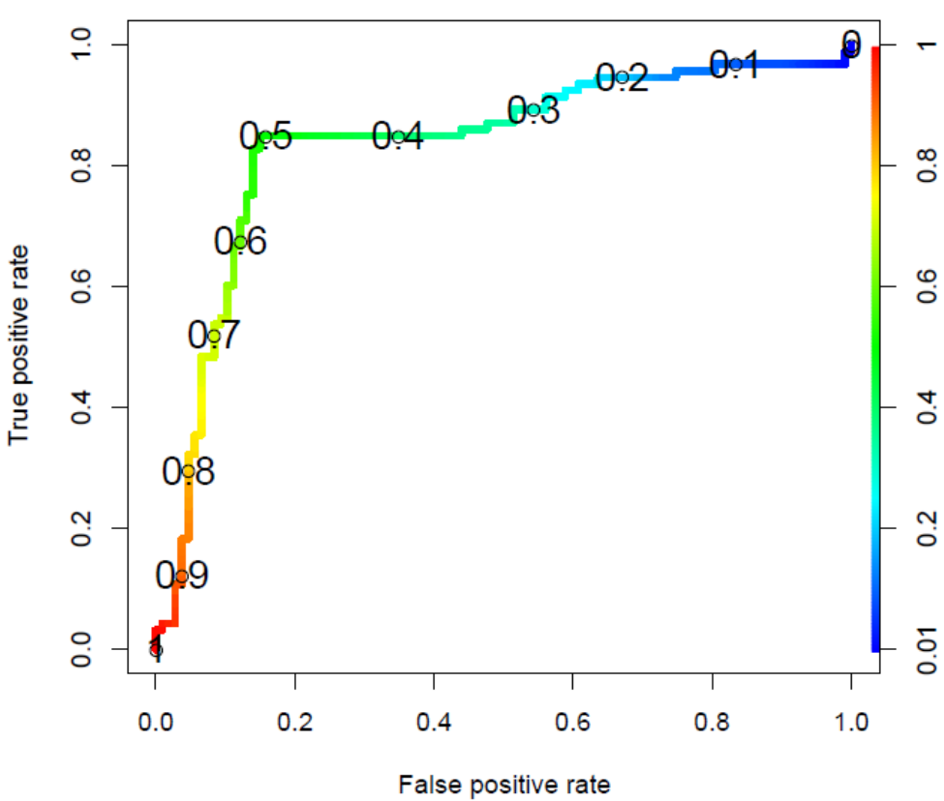
Scoring classifiers
Output: continuous
(instead of actual
class prediction)
Discretized by choosing
a cut-off
  f(x) ≥ c ➔ class „1“
  f(x) < c ➔ class „-1“
Trade-off visualizations:
cutoff-parameterized curves
Notes:
Examples: probabilities in logistic regression; distance from hyperplane in SVMs; number of trees

Slide 6
ROCR
Only three commands
  pred <- prediction( scores, labels )
  (pred: S4 object of class prediction)
  perf <- performance( pred, measure.Y, measure.X)
  (pred: S4 object of class performance)
  plot( perf )
Input format
  Single run:
  vectors (scores: numeric; labels: anything)
  Multiple runs (cross-validation, bootstrapping, …):
  matrices or lists
Notes:
~30 performance measures

Slide 7
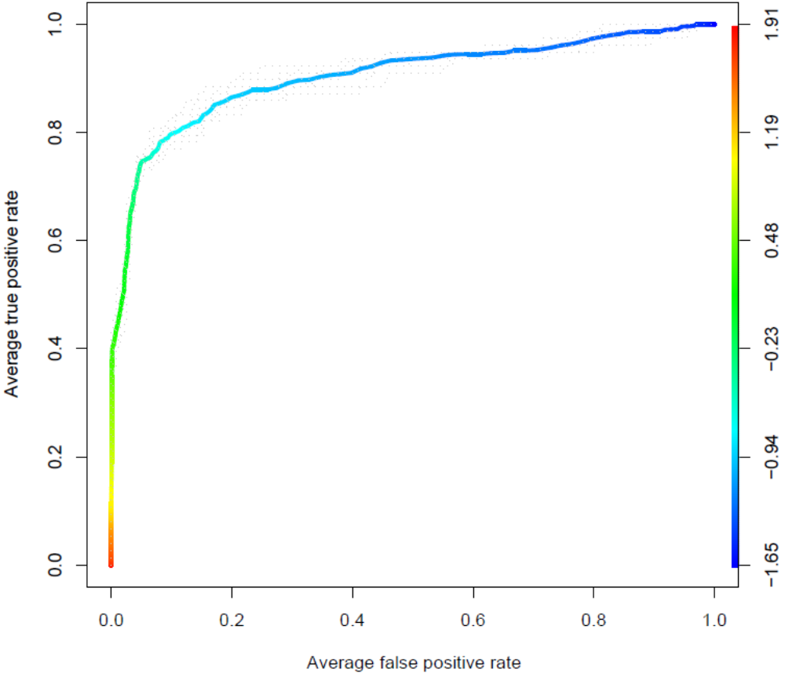
Examples (1/8): ROC curves
pred <- prediction(scores, labels)
perf <- performance(pred, "tpr", "fpr")
plot(perf, colorize=T)

Slide 8
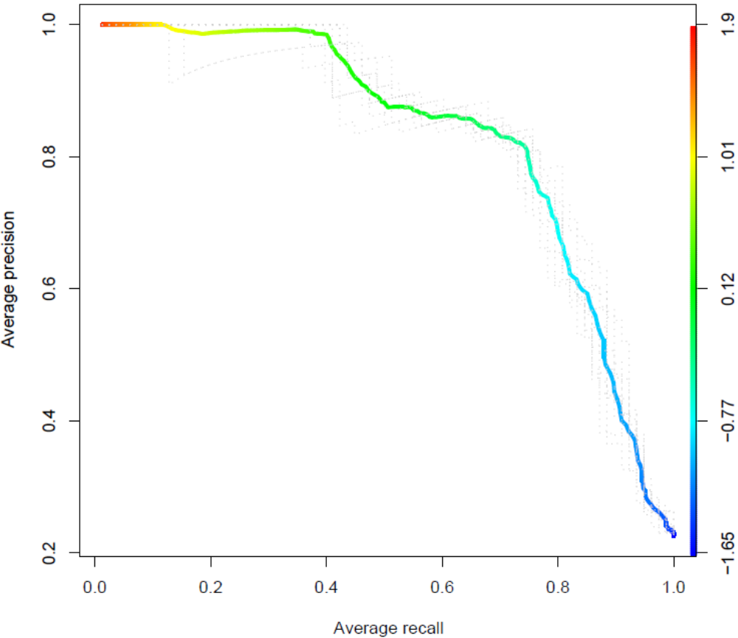
Examples (2/8): Precision/recall curves
pred <- prediction(scores, labels)
perf <- performance(pred, "prec", "rec")
plot(perf, colorize=T)

Slide 9
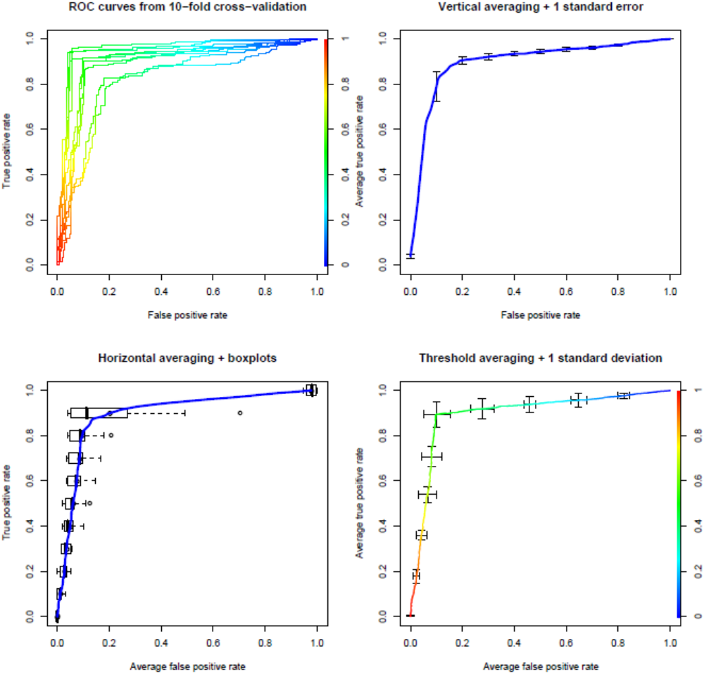
Examples (3/8): Averaging across multiple runs
pred <- prediction(scores, labels)
perf <- performance(pred, "tpr", "fpr")
plot(perf, avg='threshold', spread.estimate='stddev', colorize=T)

Slide 10
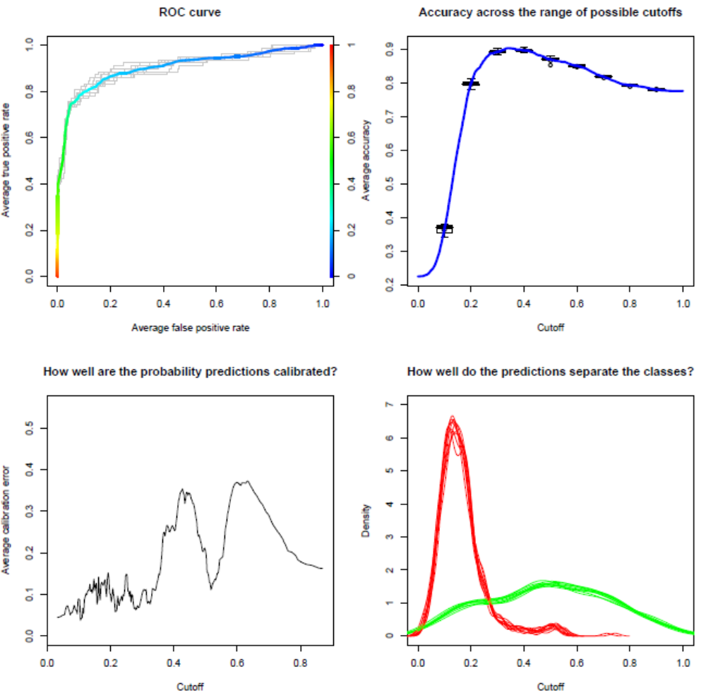
Examples (4/8): Performance vs. cutoff
perf <- performance(pred, "cal",
window.size=50)
plot(perf)
perf <- performance(pred, "acc")
plot(perf, avg= "vertical",
spread.estimate="boxplot",
show.spread.at= seq(0.1, 0.9, by=0.1))

Slide 11
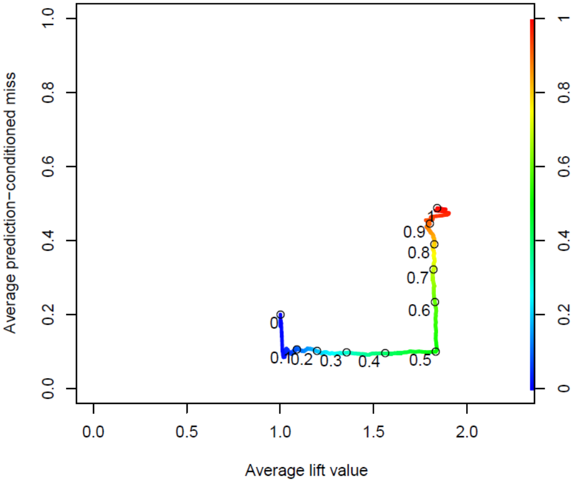
Examples (5/8): Cutoff labeling
pred <- prediction(scores, labels)
perf <- performance(pred,"pcmiss","lift")
plot(perf, colorize=T, print.cutoffs.at=seq(0,1,by=0.1), text.adj=c(1.2,1.2), avg="threshold", lwd=3)

Slide 12
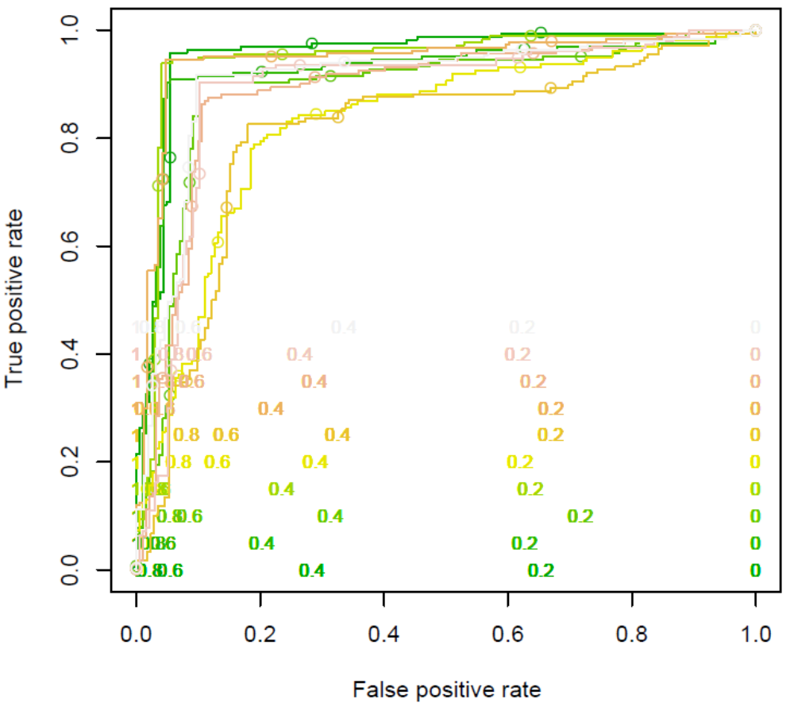
Examples (6/8): Cutoff labeling – multiple runs
plot(perf,
print.cutoffs.at=seq(0,1,by=0.2),
text.cex=0.8,
text.y=lapply(as.list(seq(0,0.5,by=0.05)),
function(x) {
rep(x,length(perf@x.values[[1]]))}),
col= as.list(terrain.colors(10)),
text.col= as.list(terrain.colors(10)),
points.col= as.list(terrain.colors(10)))

Slide 13
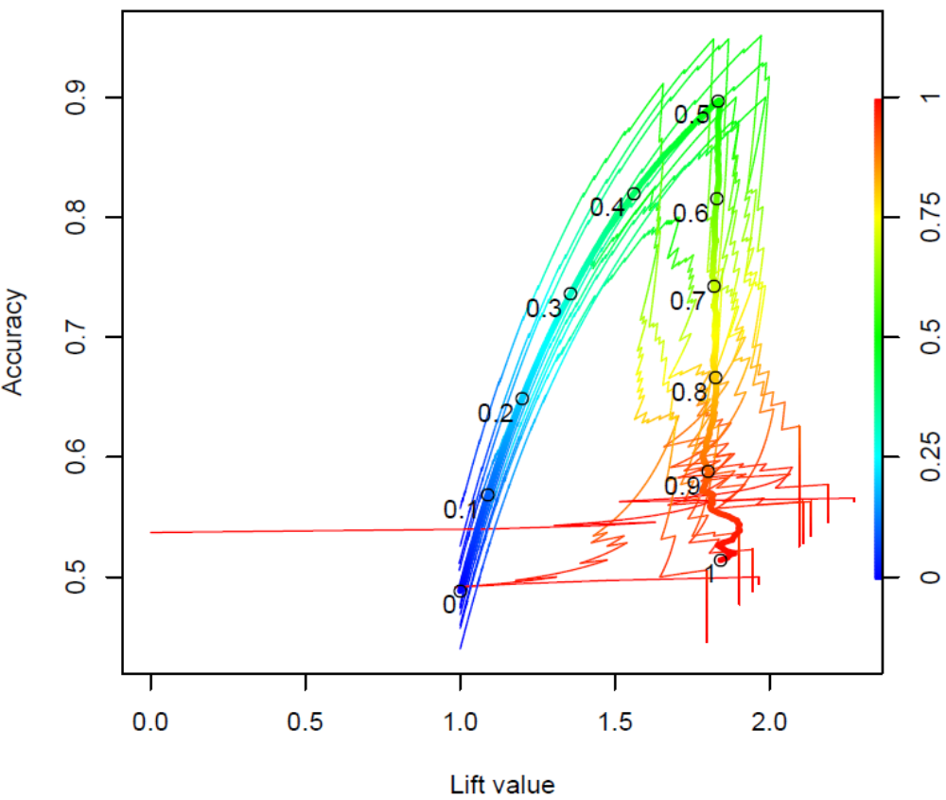
Examples (7/8): More complex trade-offs...
perf <- performance(pred,"acc","lift")
plot(perf, colorize=T)
plot(perf, colorize=T,
print.cutoffs.at=seq(0,1,by=0.1),
add=T, text.adj=c(1.2, 1.2),
avg="threshold", lwd=3)

Slide 14
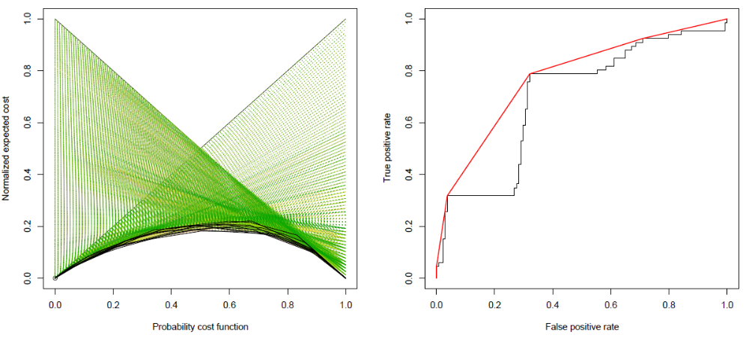
Examples (8/8): Some other examples
perf<-performance(
pred, 'ecost')
plot(perf)
perf<-performance(
pred, 'rch')
plot(perf)

Slide 15
Extending ROCR: An example
Extend environments
  assign("auc", "Area under the ROC curve",
  envir = long.unit.names)
  assign("auc", ".performance.auc",
  envir = function.names)
  assign("auc", "fpr.stop", envir=optional.arguments)
  assign("auc:fpr.stop", 1, envir=default.values)
Implement performance measure (predefined signature)
  .performance.auc <-
  function (predictions, labels, cutoffs, fp, tp, fn,
  tn, n.pos, n.neg, n.pos.pred, n.neg.pred, fpr.stop)
  {
  }

Slide 16
Thank you!
http://rocr.bioinf.mpi-sb.mpg.de
Sing et al. (2005) Bioinformatics

